Slide 1
Operating Systems
Topics
First Come First Serve (Scheduling Algorithm)
First In First Out (Page Replacement Algorithm)
Submitted By:-
Sachin Sahara (4NI19CS095)
Shrivathsa Rao B V (4NI19CS104)

Slide 2
FIRST COME FIRST SERVE (FCFS)
•FCFS scheduling algorithm, schedules the processes according to their arrival time.
•FCFS is a non-preemptive scheduling algorithm.
•In FCFS scheduling, the process with the least arrival time, among the list of available processes in the ready queue, is going to be scheduled next.
•This algorithm is very easy to understand and implement in the system.

Slide 3
Advantages
Code for FCFS is easy to write and understand.
It works well with process having long burst time.

Slide 4
Disadvantages
Short jobs(process) may have to wait for long time.
Important jobs (with higher priority) have to wait.
Cannot guarantee good response time.

Slide 5
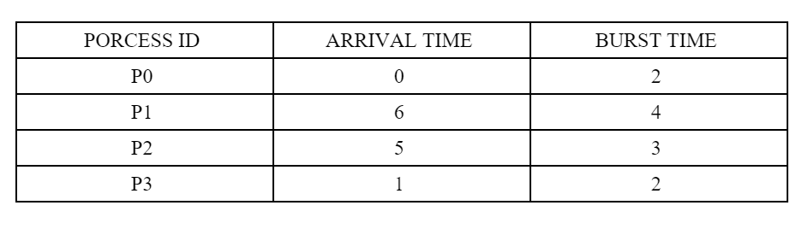
Example

Slide 6
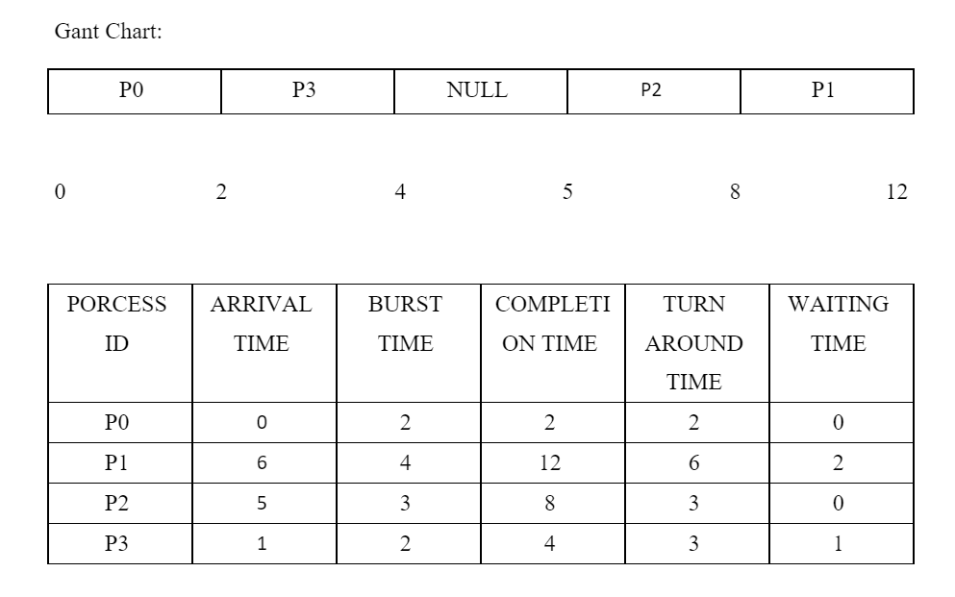

Slide 7
Calculations
Total Turn Around Time = 2+6+6+3 = 17 milliseconds
Average Turn Around Time= Total Turn Around Time / Total No. of Processes = 17 / 4 = 3.5 millisecond
Total Waiting Time = 0 + 2 + 0 +1 = 3 milliseconds
Average Waiting Time = Total Waiting Time / Total No. of Processes = 3 / 4
= 0.75 milliseconds
Total Waiting Time = 0 + 2 + 0 +1 = 3 milliseconds
Average Waiting Time = Total Waiting Time / Total No. of Processes = 3 / 4
= 0.75 milliseconds

Slide 8
Code:-
#include <bits/stdc++.h>
using namespace std;
struct process {
int pid;
int arrival_time;
int burst_time;
int start_time;
int completion_time;
int turnaround_time;
int waiting_time;
int response_time;
};
bool cmp_arrival(process const &a,process const &b){
return a.arrival_time<b.arrival_time;
}
bool cmp_process(process const &a,process const &b){
return a.pid<b.pid;
}

Slide 9
int main(){
int num_process;
cout<<"Enter the number of processes: ";
cin>>num_process;
struct process p[num_process];
float avg_turnaround_time;
float avg_waiting_time;
float avg_response_time;
int total_turnaround_time = 0;
int total_waiting_time = 0;
int total_response_time = 0;
int is_completed[num_process];
memset(is_completed,0,sizeof(is_completed));
for(int i = 0; i < num_process; i++) {
cout<<"Enter arrival time of process "<<i+1<<": ";
cin>>p[i].arrival_time;
cout<<"Enter burst time of process "<<i+1<<": ";
cin>>p[i].burst_time;
p[i].pid = i+1;
cout<<endl;
}

Slide 10
sort(p,p+num_process,cmp_arrival);
int current_time = 0;
for(int i=0;i<num_process;i++)
{
if(current_time<p[i].arrival_time){
current_time=p[i].arrival_time;
}
p[i].start_time=current_time;
p[i].completion_time=current_time+p[i].burst_time;
p[i].turnaround_time=p[i].completion_time-p[i].arrival_time;
total_turnaround_time+=p[i].turnaround_time;
p[i].waiting_time=p[i].turnaround_time-p[i].burst_time;
total_waiting_time+=p[i].waiting_time;
p[i].response_time=p[i].waiting_time;
total_response_time+=p[i].response_time;
current_time+=p[i].burst_time;
}

Slide 11
avg_turnaround_time = (float) total_turnaround_time / num_process;
avg_waiting_time = (float) total_waiting_time / num_process;
avg_response_time = (float) total_response_time / num_process;
cout<<endl<<endl;
cout<<"Process ID\t"<<"AT\t"<<"BT\t"<<"ST\t"<<"CT\t"<<"TAT\t"<<"WT\t"<<"RT\t"<<"\n"<<endl;
sort(p,p+num_process,cmp_process);
for(int i = 0; i < num_process; i++) {
cout<<"P"<<p[i].pid<<"\t\t"<<p[i].arrival_time<<"\t"<<p[i].burst_time<<"\t"<<p[i].start_time<<"\t"<<p[i].completion_time<<"\t"<<p[i].turnaround_time<<"\t"<<p[i].waiting_time<<"\t"<<p[i].response_time<<"\t"<<"\n"<<endl;
}
cout<<"Average Turnaround Time = "<<avg_turnaround_time<<endl;
cout<<"Average Waiting Time = "<<avg_waiting_time<<endl;
cout<<"Average Response Time = "<<avg_response_time<<endl;
return 0;
}

Slide 12
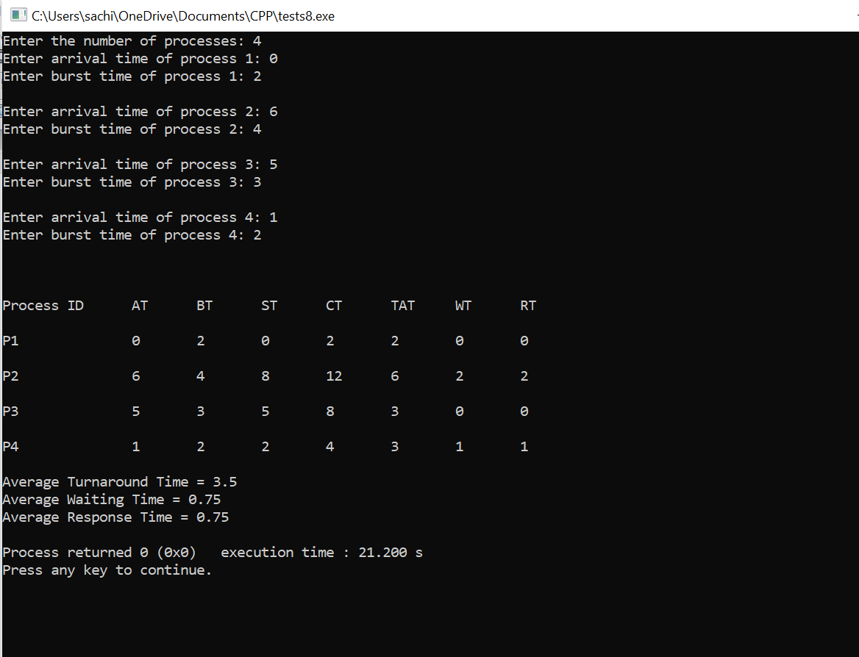
Output:-

Slide 13
First In First Out (FIFO)
It is one of the simplest page replacement algorithm. The oldest page, which has spent the longest time in memory is chosen and replaced.
• This algorithm is implemented by keeping the track of all the pages in the queue.
• As new pages are requested and are swapped in, they are added to the tail of a queue and the page which is at the head becomes the victim.
• This is not an effective way of page replacement but it can be used for small systems.

Slide 14
Advantages
•This algorithm is simple and easy to use.
•FIFO does not cause more overhead.

Slide 15
Disadvantages
•Not always good at performance. It may replace an active page to bring a new one and thus may cause a page fault of that page immediately.
•Another unexpected side effect is the FIFO anomaly or Belady’s anomaly.

Slide 16
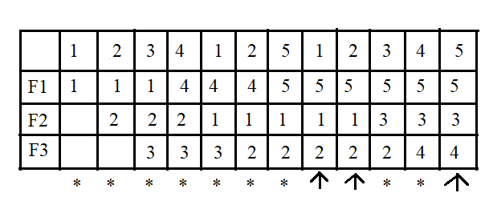
Example
Reference String: 1 2 3 4 1 2 5 1 2 3 4 5
No. Of Frames:- 3
No. of Page Fault=9
No. of Hits=3
Miss Ratio=9/12=0.75
Hit Ratio=0.25

Slide 17
Code:-
#include<bits/stdc++.h>
using namespace std;
int main()
{
int i,j,n,ref_str[50],frame[10],no,k,avail;
float fcount=0;
printf("\nENTER THE NUMBER OF PAGES:\n");
scanf("%d",&n);
printf("\nENTER THE REFERENCE STRING :\n");
for(i=1;i<=n;i++)
scanf("%d",&ref_str[i]);
printf("\nENTER THE NUMBER OF FRAMES :");
scanf("%d",&no);
for(i=0;i<no;i++)
frame[i]= -1;
j=0;

Slide 18
printf("\n ref string \t page frames \tHit/Fault\n");
for(i=1;i<=n;i++)
{
printf("%d\t\t",ref_str[i]);
avail=0;
for(k=0;k<no;k++)
{
if(frame[k]==ref_str[i])
{
avail=1;
for(k=0;k<no;k++)
printf("%d\t",frame[k]);
printf("H");
}
}
if (avail==0)
{
frame[j]=ref_str[i];
j=(j+1)%no;
fcount++;
for(k=0;k<no;k++)
printf("%d\t",frame[k]);
printf("F");
}
printf("\n");
}

Slide 19
printf("Page Fault Is %.1f\n",fcount);
cout<<"Hit ratio: "<<((n-fcount)/n)<<"\n";
cout<<"Miss ratio: "<<(fcount/n);
return 0;
}

Slide 20
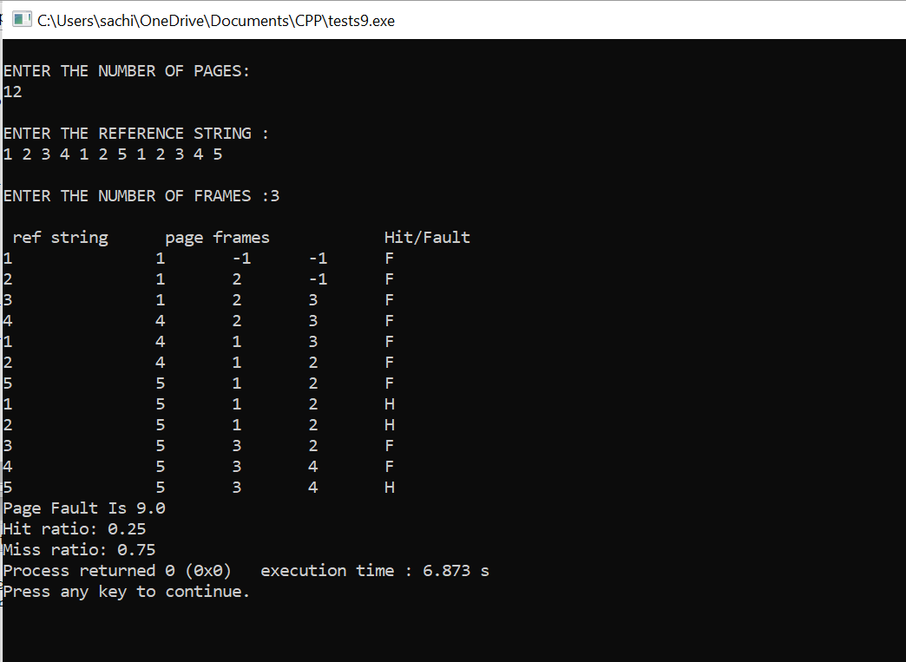
Output:-

Slide 21
Thank you

